Slide 1

Department of Information Technology
A.P. Shah Institute of Technology
G.B.Road,Kasarvadavli, Thane(W), Mumbai-400615
UNIVERSITY OF MUMBAI
Academic Year 2020-2021

Slide 2
A Project Report on
TRAVEL GUIDE: A SMART NAVIGATION AT CLICK
Submitted in partial fulfillment of the degree of
Bachelor of Engineering(Sem-8)
in
INFORMATION TECHNOLOGY
By
Ashutosh joshi (17104001)
Prashant jain (17104038)
Rahul guduri (16104032)
Under the Guidance of
Prof. Vishal Badgujar

Slide 3
1.Project Conception and Initiation

Slide 4
1.1 Abstract
“Bus Tracking System” is an application for Smart phones that works on Android Operating system.
At specific pickup point app will send the current location of the bus to travelers when they request.
This app generate predictions of bus arrivals at stops along the route.
It uses a variety of technologies to track the locations of buses in real time.

Slide 5
1.2 Objectives
To implement bus tracking system to get real time location of the bus.
To alert the users through notification system whenever the stop is about to come.
To show users popular places in real time.
To implement android app to provide users with schedule between two places

Slide 6
1.3 Literature Review
Author Name | Paper Title | Advantages | Disadvantages
1.Dr. Chaya Bagrecha and Sadiq Alam | “Challenges and opportunities in online reservations” | It showcases how services should be met according to the desire of the passengers. | The paper laid out is very complicated and not clear.
2.Sujo Thomas, Bharthi Pathak | “The Growth of Online Bus Ticketing Industry” | The paper went very deep into the strategies of redbus. | The strategies laid out is very limited and not suited to the current times.
3.Sulaiman, A., Ng, J., &Mohezar, S | “E-ticketing as a new way of buying tickets” | It focus on the motivational factors that influence online buying. | It only focuses on a minor segment of motivation to buy online tickets.

Slide 7
Literature Review
Author Name | Paper Title | Advantages | Disadvantages
4. R. Ramya | “Customer satisfaction on online bus ticket booking” | The paper was full of statistics and very detailed on the satisfaction aspect. | The paper is highly limited to only customer satisfaction side of things.
5. T.D. Camacho, M. Foth, and A. Rakotonirainy | “Pervasive technology and public transport” | The paper was very different than other which talked about pervasive technology. | The paper failed to explain in-depth applications of pervasive technology in public transport.

Slide 8
1.4 Problem Definition
Buses do not reach station on time and causes the passengers havoc,passangers are not sure whether they should wait for the bus or use another mode of transport.
The manual ticket checking system sometimes causes error and some passengers travel without tickets.
Some time passenger needs to queue up long time to get the bus timing or bus information.
Even passenger should have to know that how much time bus will take to reach their destination.

Slide 9
1.5 Scope
The application will prove beneficial for every bus traveler, or even tourists.
Not just buses, but this application will be useful for every person travelling by any means of transport.
The Location Tracker will give the exact location of the bus which will make it easy for the passengers to travel.

Slide 10
1.6 Technology stack
Software Requirements:
Operating System : Android 4.1 or higher
Front-end : Android Studio
Back-end : SQLite Database
Apache HTTP Server

Slide 11
1.7 Benefits for environment & Society
Reduces traffic in clumsy areas.
Makes people to avoid unexpected delays.
Improves scheduling of vehicle timings.
Easy to catch local transports.

Slide 12
2. Project Design

Slide 13
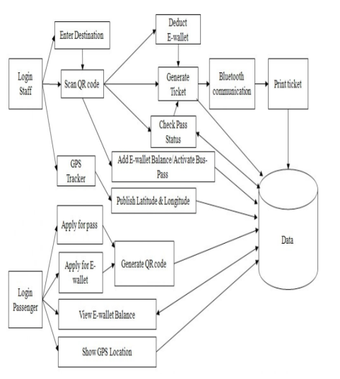
2.1 Proposed System

Slide 14
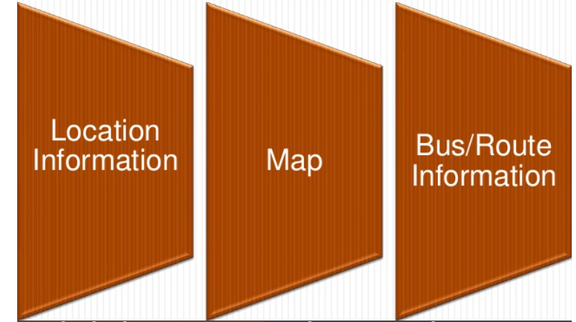
2.2 Design(Flow Of Modules)

Slide 15
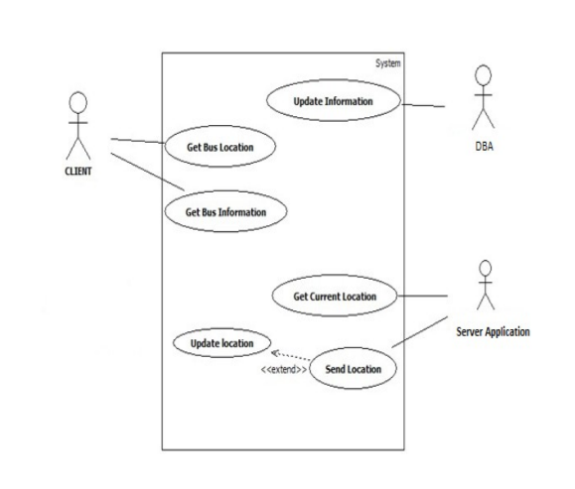
2.3 Description Of Use Case
It is the depiction of a user's possible interactions with a system.

Slide 16
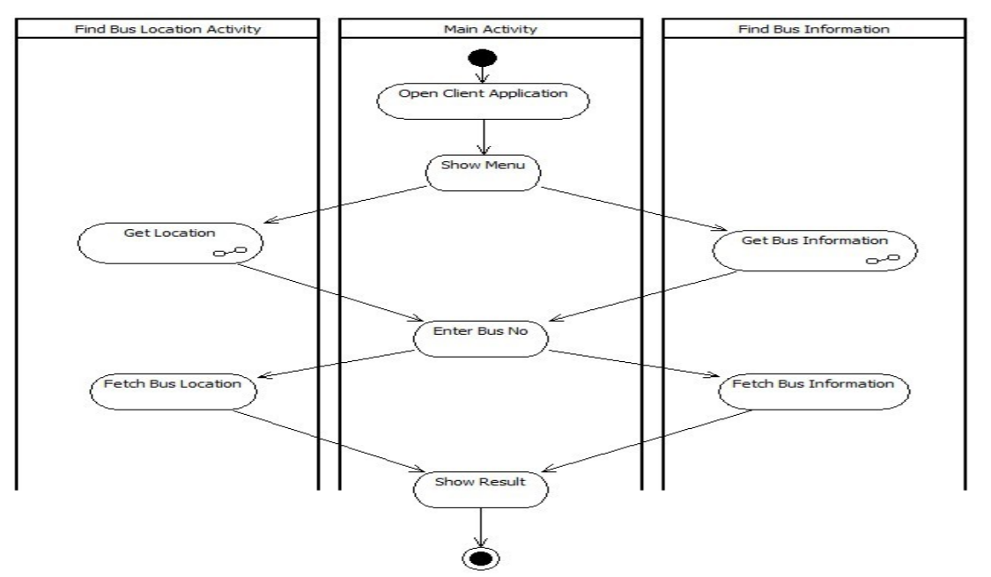
2.4 Activity diagram
Graphical representations of workflows of stepwise activities and actions with support for choice, iteration and concurrency.

Slide 17
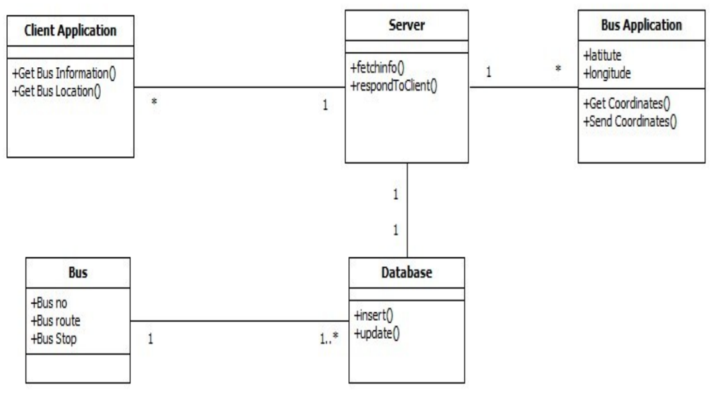
2.5 Class Diagram
It describes the structure of a system by showing the system's classes, their attributes, operations (or methods), and the relationships among objects.

Slide 18
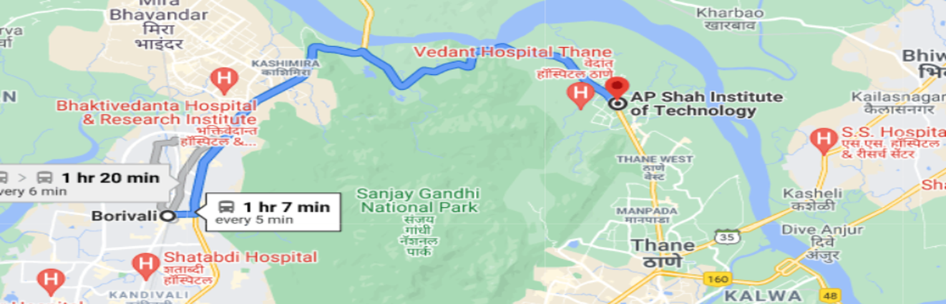
2.6 Module-1 Location Information
This module depicts the process of selection of Bus no and presenting the current location of the Bus.
GPS – Global Positioning System. Client-Server Technology

Slide 19
Module-2 Maps
In this Module; application is using Google-API to show the Maps.

Slide 20
Module-3 Bus Information
The Routes of all Buses are recorded by Bus In-charge of college.
For this purpose we have used SQLite.
Bus In-charge will update all info regarding routes.
Now when client makes request for the Bus Information it will be fetched from the database and delivered to client through server.

Slide 21
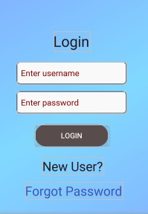
RESULT- Login Page
This is the login page of our app. From here, travellers can login or if they are new user they can register.

Slide 22
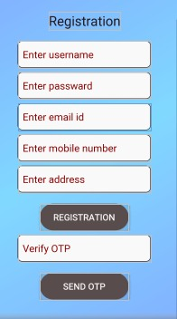
2.User Registration
Here new users can register themselves by filling out necessary details.

Slide 23
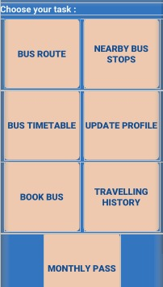
3.Menu Page
This is the menu page where travellers can click any option based on his goal.

Slide 24
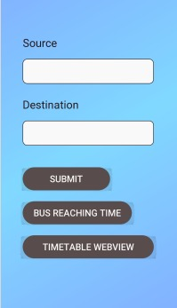
4.Bus Timetable
Traveller can enter the source and destination and will get the list of all buses.

Slide 25
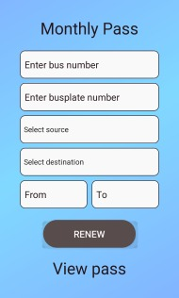
5.Pass
Users can book the passes for buses and can pay through payment gateway.

Slide 26
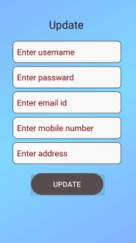
6.User Profile Update
If any user has to update the profile this is the section to go.

Slide 27
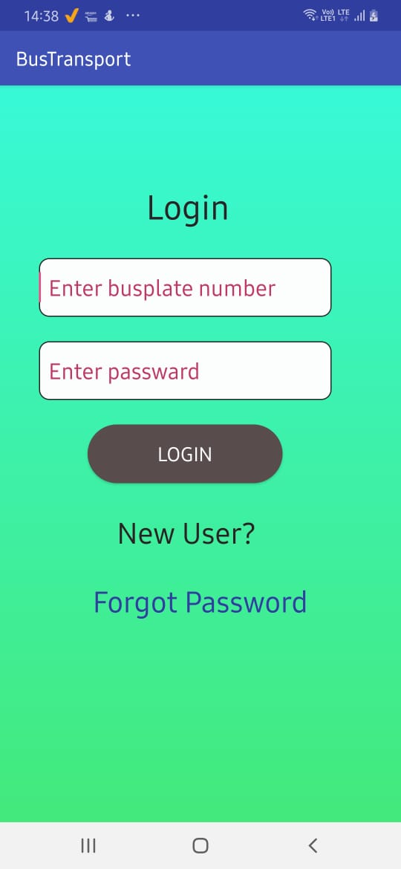
ADMIN SIDE- LOGIN
From here admin can login.

Slide 28
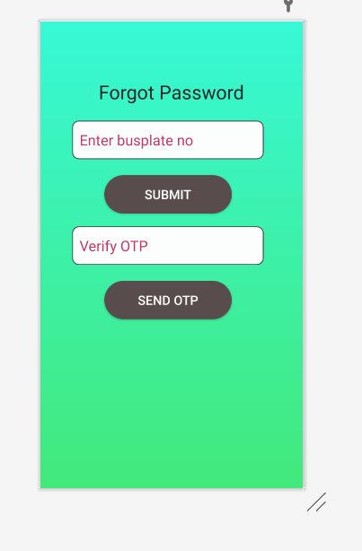
2.Forgot Password
If admin forgot password then he can change it from here.

Slide 29
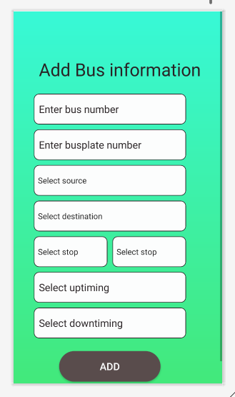
3.Add Bus Information
This is where admin can add information of different buses.

Slide 30
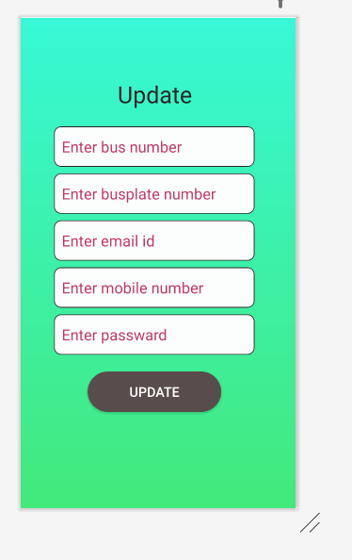
4.Bus Update
Admin can update the information of the bus from here.

Slide 31
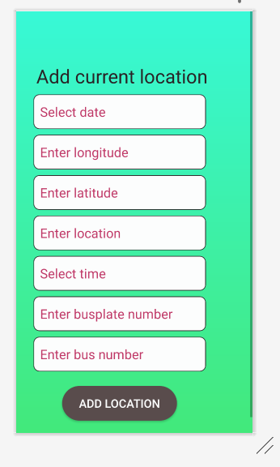
5.Add Current Location
From here, admin will add current location of the bus.

Slide 32
3. Conclusion and Future Scope

Slide 33
CONCLUSION
Bus tracking ticketing system is very useful and important mainly in cities .
This system has many advantages like easy to use , wide area range , easy to implement in vehicles , more effective , huge capacity etc. This system is made of a tracking module containing GPS model to access dynamic vehicle location and send it to server .
Then people can access this information from their android mobile phones. The system will allow the user to find the bus current place without the help of other persons. In future we try to implement this application based on server.

Slide 34
2.7 References
Dr. Chaya Bagrecha and Sadiq Alam, “challenges and opportunities in online reservations” International Journal of management and engineering, online journal, 2015.
Sujo Thomas, Bharthi Pathak, ‘The Growth of Online Bus Ticketing Industry: RedBus Route to Success in the Indian Market’, International Journal of Business and Management; Vol. 9, No. 11; 2014, ISSN 1833- 3850.
Sulaiman, A., Ng, J., &Mohezar, S. (2008). E-ticketing as a new way of buying tickets: Malaysian perceptions. Journal of Social Science, 17(2), 149-157. • Ramya, R. Customer satisfaction on online bus ticket booking.

Slide 35
References
R. Ramya undertook the project entitled “customer satisfaction on online bus ticket booking” IOSR Journal of Business and Management.
T.D. Camacho, M. Foth, and A. Rakotonirainy, “Pervasive technology and public transport: Opportunities beyond telematics,” Pervasive Computing , vol. 12, iss. 1, pp. 18–25, 2013

Slide 36
Thank You

